Slide 1

Machine Learning
Project Description Document

Slide 2

20210728
محمد احمد حنفي اسماعيل
20210157
اسلام عادل احمد عبدالرازق
20210130
احمد يسري عبدالعزيز
20210478
ضياء الدين محمود صبحى
20210479
طارق محمد يحي
20210404
ستيفن ايمن فايق فخرى

Slide 3
Regression Model

Slide 4
General Information on dataset

Slide 5
Regression Dataset
DataSet Name:
fifa_data
Our Lable:
Player Overall
Number of samples:
18207 Sample
Number of samples
Train:
12945
Test:
3237

Slide 6
Implementation details

Slide 7
Regression Model
At feature extraction phase:
Number of features: 22
There names: ['Age', ‘Potential', 'International Reputation', 'Weak Foot’,'Skill Moves’, ‘Value’, ‘wage ’Position’]
The Dimension of resulted features: (16182, 22)

Slide 8
Regression Model
Hyperparameters:
Optimizer: Adam
Regularization strength: 0.0001
Batch size: 32
epochs: 150
Number Of Hidden Layers: 2
Hidden Layer 1 Neurons: 400
Hidden Layer 2 Neurons: 200
Hidden Layers Activation Function: Relu
Output Layer Activation Function: Linear

Slide 9
Results details

Slide 10

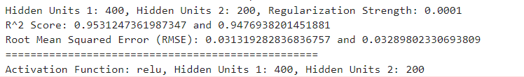
Regression Model
ANN
Accuracy measures

Slide 11
Regression Model
Conformal Prediction

Slide 12
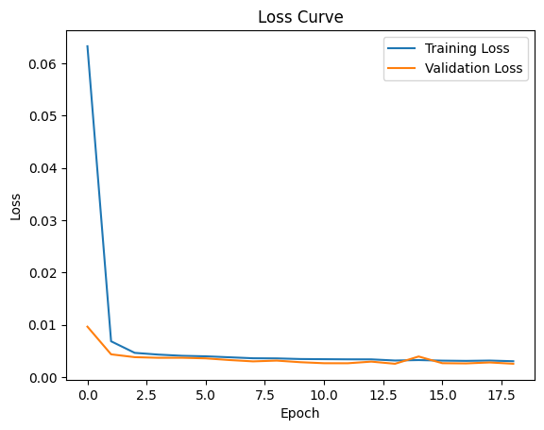
Regression Model

Slide 13
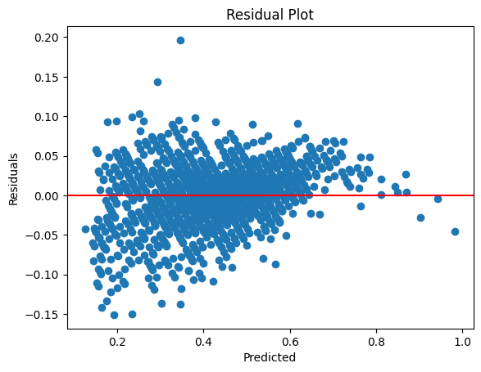
Regression Model

Slide 14
Classification Model(Decision Tree)

Slide 15
General Information on dataset

Slide 16
Classification Dataset
DataSet Name:
Mushroom Classification
Number of samples:
2 Classes
Our Lables:
Edible = e
Poisonous = p
Number of samples:
8124 Sample
Number of samples
Train:
6093
Test:
2031

Slide 17
Implementation details

Slide 18
Classification Model(Decision Tree)
At feature extraction phase:
PCA Is Used
PCA Components: 7

Slide 19
Classification Model(Decision Tree)
Hyperparameter Tuning:
Criterion: entropy
Max Depth: 7

Slide 20
Results details

Slide 21
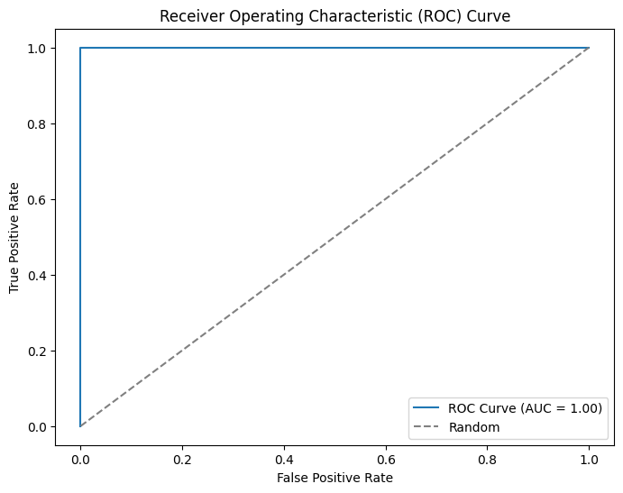
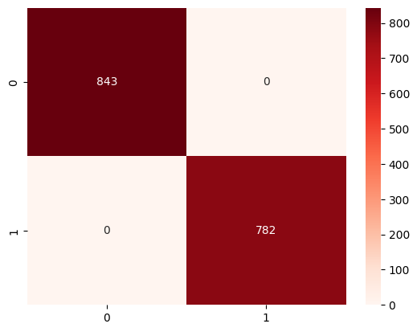
Classification Model(Decision Tree)
Decision Tree
ROC
Confusion matrix

Slide 22
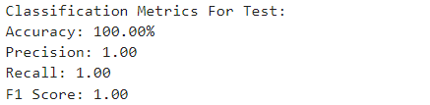
Classification Model(Decision Tree)
Decision Tree (Accuracy & Classification report)

Slide 23
Classification Model(SVM)

Slide 24
General Information on dataset

Slide 25
Classification Model
DataSet Name:
Mushroom Classification
Number of samples:
2 Classes
Our Lables:
Edible = e
Poisonous = p
Number of samples:
8124 Sample
Number of samples
Train:
6093
Test:
2031

Slide 26
Implementation details

Slide 27
Classification Model
At feature extraction phase:
Number of features: 22
There names: ['Age', ‘Potential', 'International Reputation', 'Weak Foot’,'Skill Moves’, ‘Value’, ‘wage ’Position’]
CV folds : 5
The Dimension of resulted features: (6093, 22)

Slide 28
Classification Model(SVM)
Hyperparameter Tuning:
reguralization : C= 1
optimizer : gamma = 0.1
kernel type : poly
batch size : 75 % of training : 6093

Slide 29
Results details

Slide 30
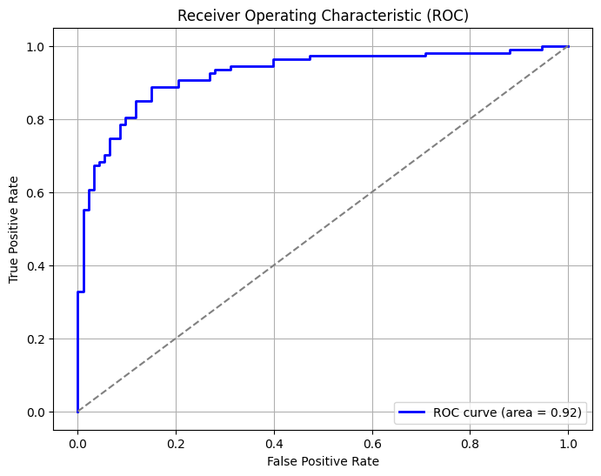
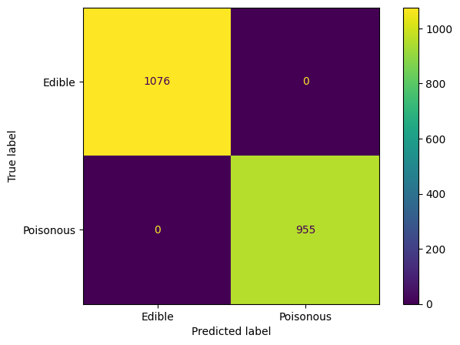
Classification Model(SVM)
SVM
ROC
Confusion matrix

Slide 31
Classification Model(SVM)
SVM (Accuracy & Classification report)

Slide 32
Thanks

